Slide 1


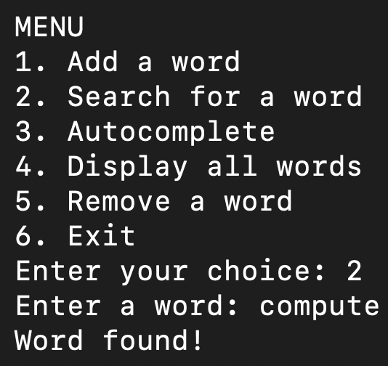
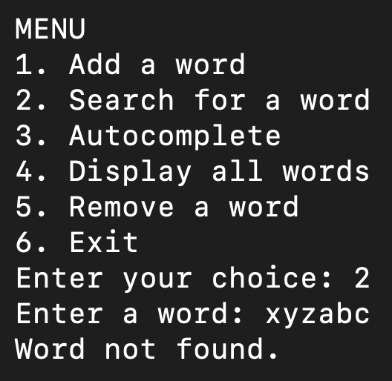
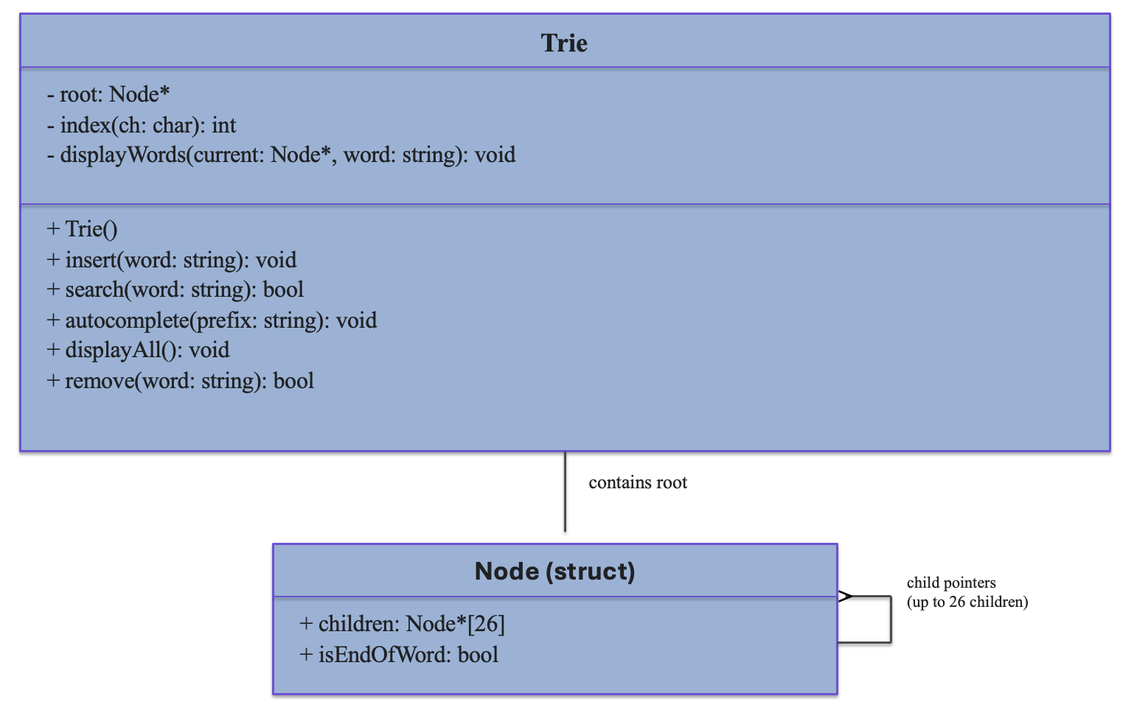
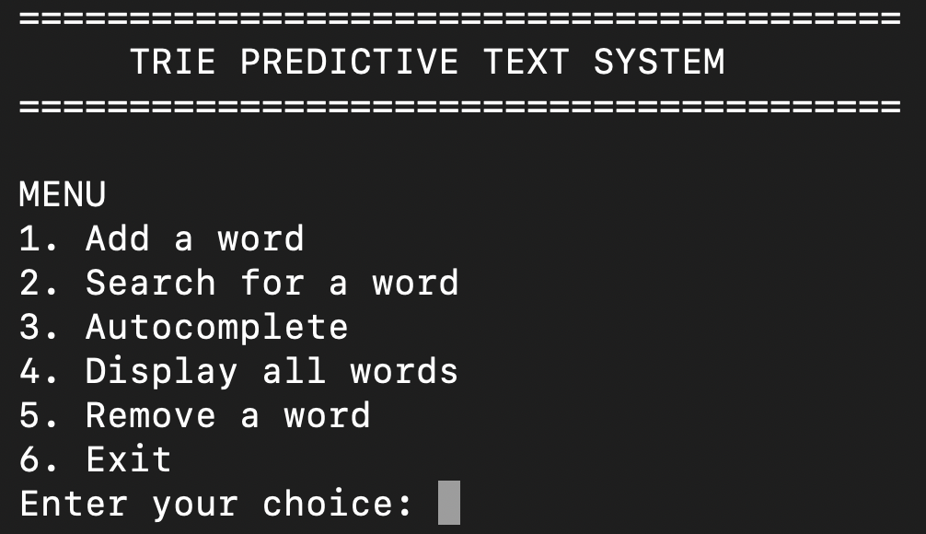
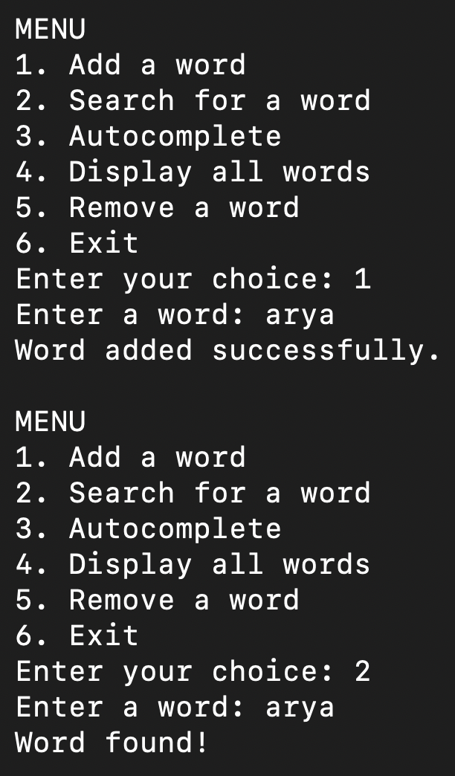
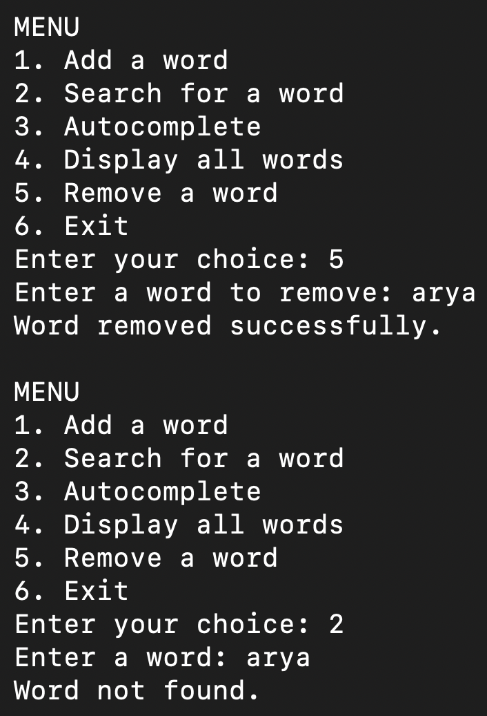
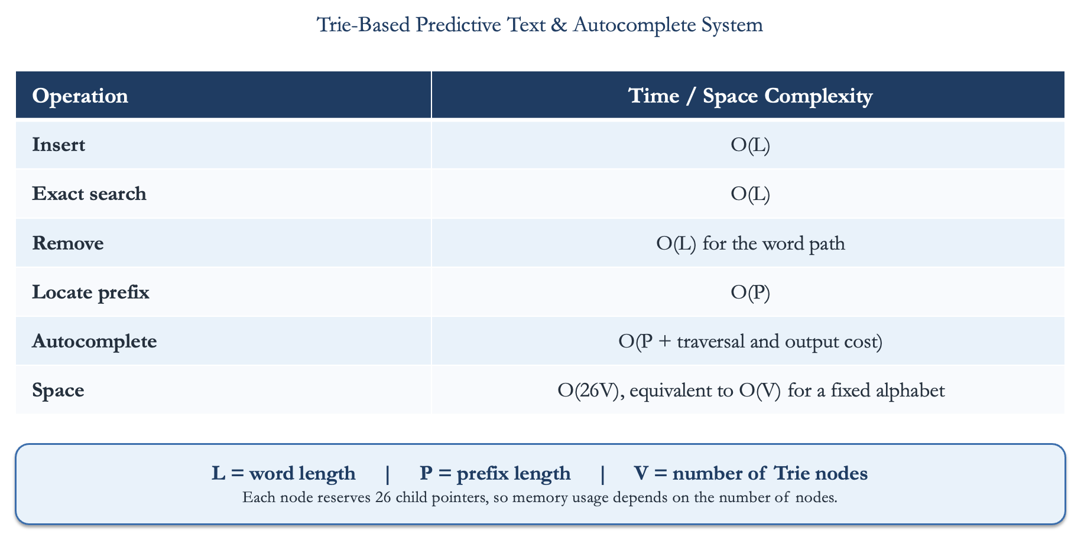
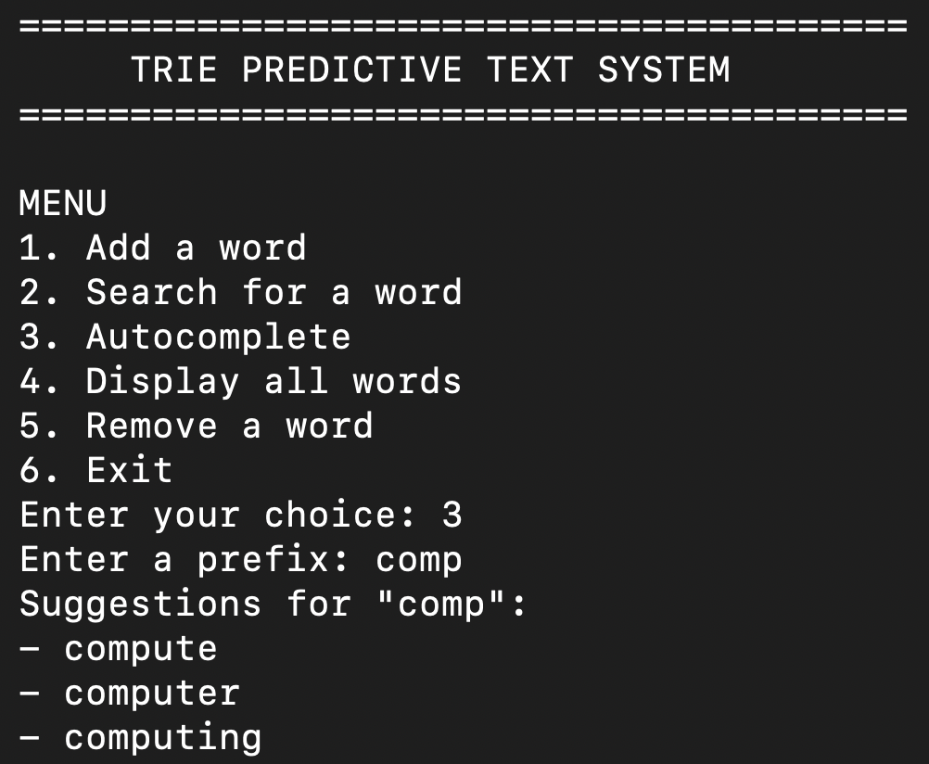
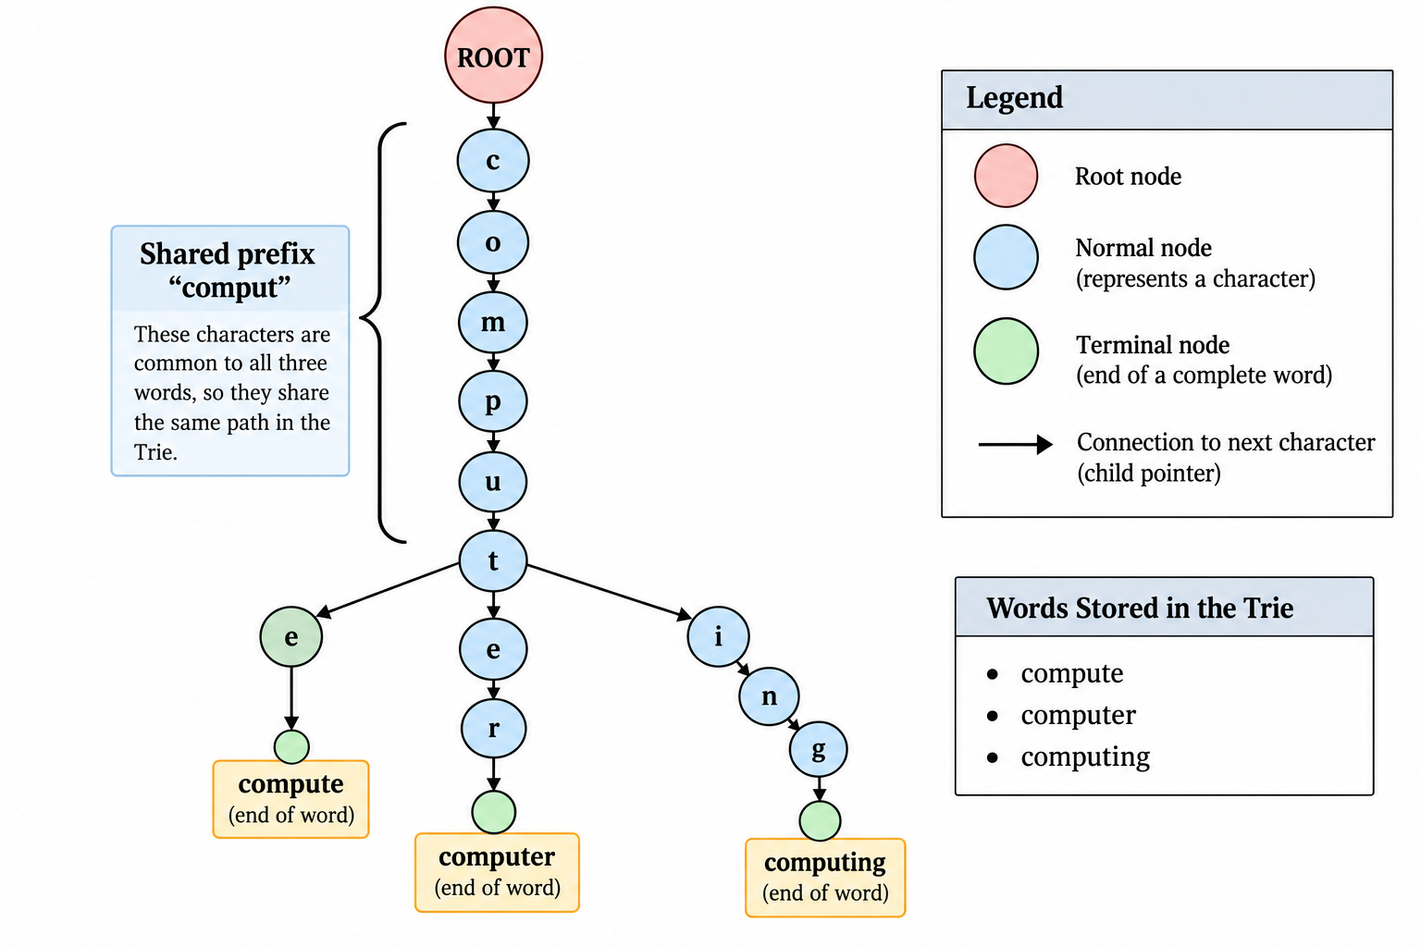
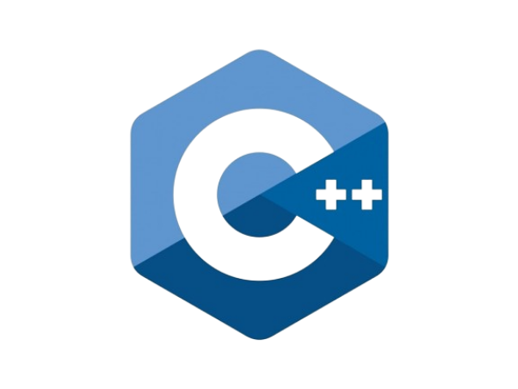
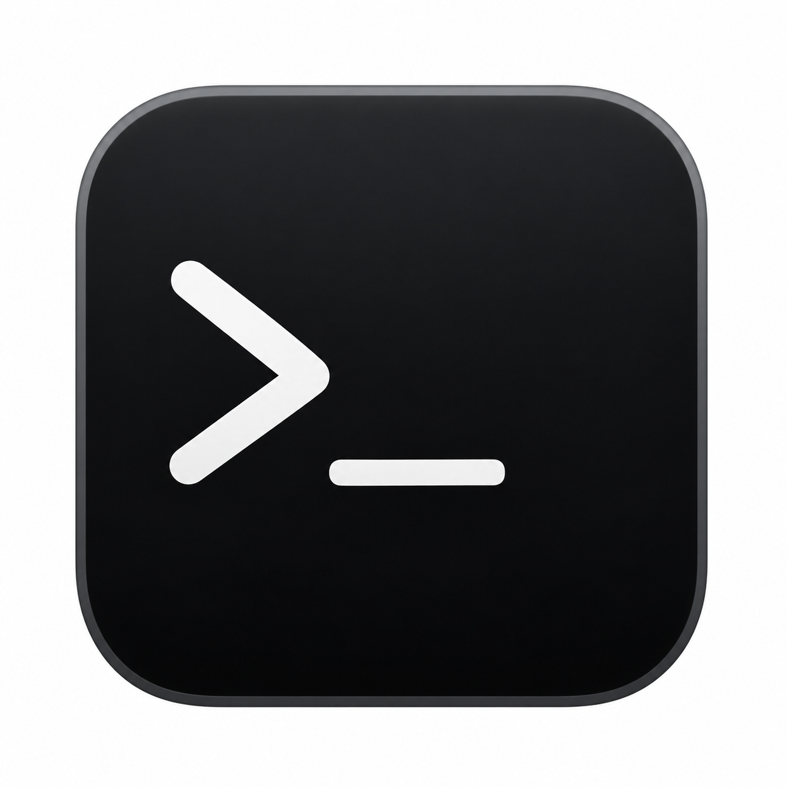

Trie-Based Predictive Text & Autocomplete System Using C++
Arya Desai
Faculty Advisor: Dr. Victor Govindaswamy
Concordia University Chicago
Abstract
C++ Application Features
Exact Word Search
UML
Predictive text and autocomplete systems help users enter words more quickly by suggesting possible completions based on the characters they type. This project implements a Trie data structure in C++ to develop a menu-based predictive text and autocomplete application. The program supports inserting new words, searching for existing words, generating autocomplete suggestions, displaying stored words, and removing words from the vocabulary. It also includes input validation and a predefined vocabulary to demonstrate the main operations. The project examines the efficiency of Trie operations and explores their connection to Artificial Intelligence (AI) and Natural Language Processing (NLP) through prefix matching.
The program uses a menu-driven interface to make Trie operations accessible to the user.
Menu Options
Add a word
Search for a word
Autocomplete
Display all words
Remove a word
Exit
Input Validation
Rejects empty input.
Accepts alphabetic words.
Converts uppercase letters to lowercase.
Displays appropriate messages when a word is missing or no suggestions are available.
Add and Remove a Word
Time and Space Complexity
What Is a Trie?
A Trie is a tree-based data structure that stores words character by character. Words with common prefixes share the same paths, reducing repeated prefix storage and enabling efficient word searching and autocomplete.
Key Components
Root node: Starting point of the Trie.
Child pointers: Connect characters to subsequent nodes.
End-of-word flag: Identifies the completion of a stored word.
Shared prefixes: Allow related words to reuse character paths.
Autocomplete Demonstration
Advantages and Limitations
Connection to AI and NLP
Advantages
Efficient exact-word and prefix searching.
Shared paths reduce repeated prefix storage.
Supports insertion, search, autocomplete, display, and removal.
Simple and organized C++ implementation.
Limitations
Requires additional memory for child pointers.
Supports alphabetic English input only.
Does not rank suggestions by frequency or relevance.
Cannot understand sentence context or user intent.
Large vocabularies may require optimization.
Trie-based autocomplete supports text-processing tasks by retrieving possible word completions from partial input. This makes it relevant to features used in search engines, predictive text, and other language-related applications.
The current implementation uses prefix matching rather than machine learning or contextual language prediction. However, it demonstrates how a fundamental data structure can support a component of a larger AI- or NLP-assisted system.
Workflow
Partial Input → Trie Prefix Lookup → Matching Vocabulary → Candidate Suggestions
Contacts
Real-World Applications
Bioinformatics And Technology Laboratory (BAT Lab)
- Programming Application Implementation and Design (PAID)
Computer Science Department (CSC@CUC)
Member: Arya Desai
Advisor: Dr Visvasuresh (Victor) Govindaswamy
Email: Victor.Govindaswamy@cuchicago.edu
Address: Concordia Chicago University
7400 Augusta Street
River Forest, IL, 60305-1499
The Trie-based autocomplete system searches for words using a prefix entered by the user. It follows the matching character path and retrieves words that begin with that prefix. For example, entering “comp” produces the suggestions compute, computer, and computing. This demonstrates how a Trie supports efficient prefix matching and word retrieval in C++.
Trie data structures are used in applications such as search autocomplete, predictive text on mobile devices, dictionary lookup, and spell-checking support. They also help perform prefix-based word searches and organize vocabulary efficiently. These applications demonstrate how Tries can improve word retrieval and support text-processing systems.
Technologies Used

